Slide 1

Palindrome Numbers
Name: Govinda Roll No:BIT-24S-032
An exploration into the fascinating world of palindrome numbers.

Slide 2
Definition of Palindrome Numbers
A palindrome number is a number that remains the same when its digits are reversed. In other words, if you read the number from left to right and right to left, it will look identical.

Slide 3
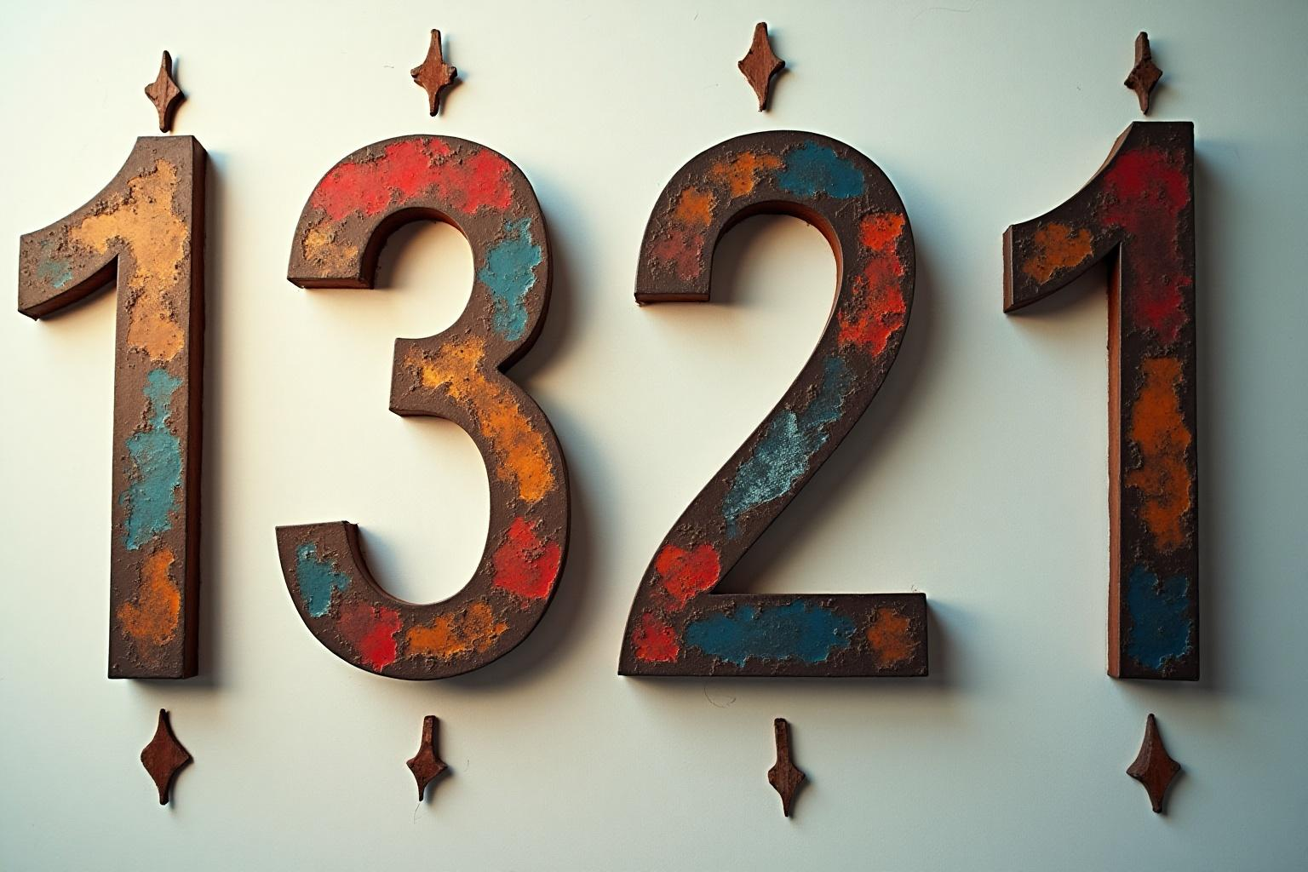
KeyPoints
A number is a palindrome if the number is equal to its reverse.
Palindrome numbers can have any number of digits (e.g., single-digit numbers are trivially palindromes).
Negative numbers are not considered palindromes because the negative sign would not match when reversed.

Slide 4
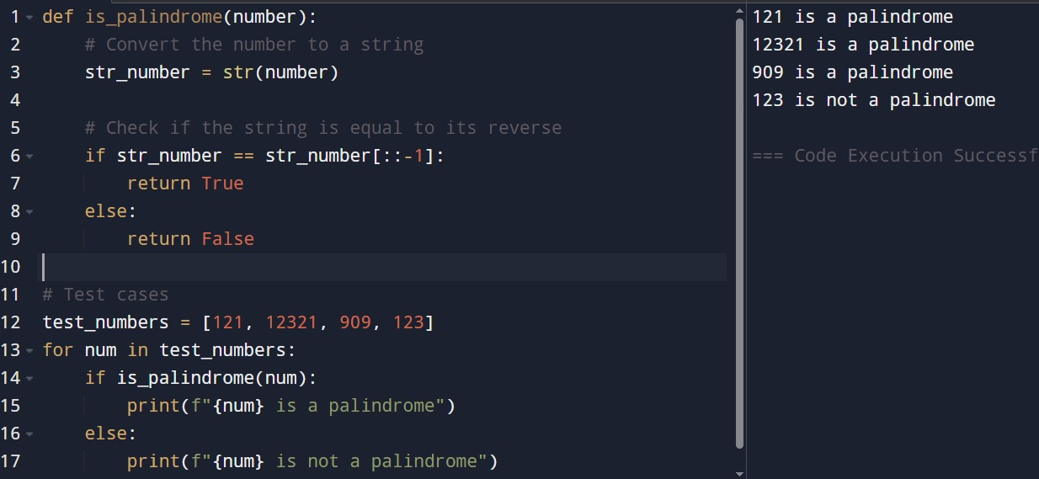

Slide 5

Roman to Integer
The Roman numeral system is an ancient numeral system used in ancient Rome. It uses combinations of letters from the Latin alphabet (I, V, X, L, C, D, M) to represent values. When converting a Roman numeral to an integer, certain rules are followed. Roman Numerals and their Integer Values: I = 1 V = 5 X = 10 L = 50 C = 100 D = 500 M = 1000

Slide 6

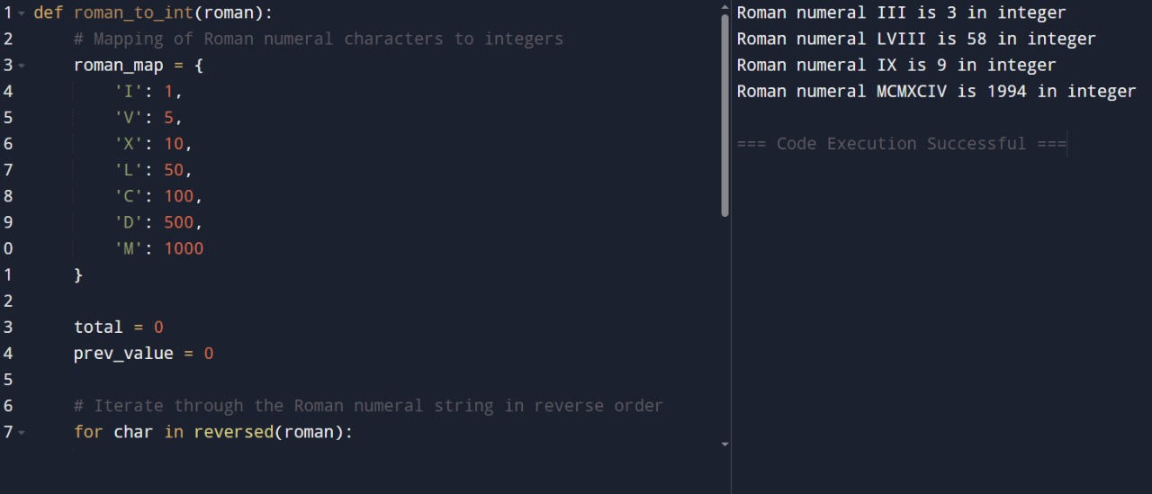

Slide 7
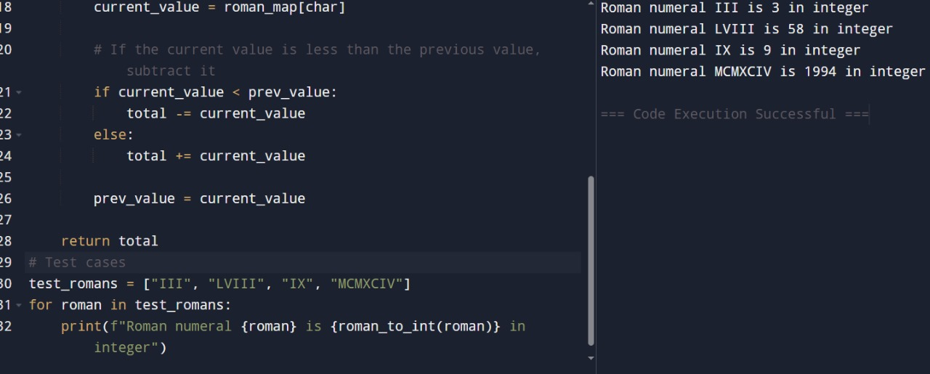

Slide 8
ThankYou

